Slide 1
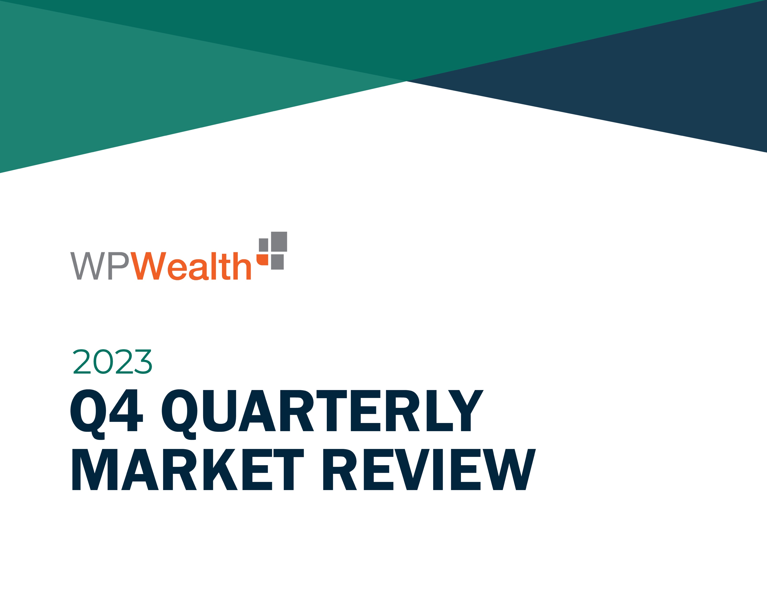
Q4
Quarterly Market Review
Fourth Quarter 2023
135202

Slide 2

Quarterly Market Review
Fourth quarter 2023
This report features world capital market performance and a timeline of events for the past quarter. It begins with a global overview, then features the returns of stock and bond asset classes in the US and international markets. The report concludes with a quarterly topic.
Overview:
  Market Summary
  World Stock Market Performance
  US Stocks
  International Developed Stocks
  Emerging Markets Stocks
  Country Returns
  Real Estate Investment Trusts (REITs)
  Commodities
  Fixed Income
  Global Fixed Income
  Quarterly Topic: Country Debt and Stock Returns
135210

Slide 3
Quarterly Market Summary
Index returns
 | US Stock Market | International Developed Stocks | Emerging Markets Stocks | Global Real Estate |  | US Bond Market | Global Bond Market ex US
Q4 2023 | STOCKS |  |  |  |  | BONDS
 | 12.07% | 10.51% | 7.86% | 15.47% |  | 6.82% | 5.36%
Since Jan. 2001
Average Quarterly Return | 2.3% | 1.6% | 2.5% | 2.3% |  | 0.9% | 0.9%
Best | 22.0% | 25.9% | 34.7% | 32.3% |  | 6.8% | 5.4%
Quarter | 2020 Q2 | 2009 Q2 | 2009 Q2 | 2009 Q3 |  | 2023 Q4 | 2023 Q4
Worst | -22.8% | -23.3% | -27.6% | -36.1% |  | -5.9% | -4.1%
Quarter | 2008 Q4 | 2020 Q1 | 2008 Q4 | 2008 Q4 |  | 2022 Q1 | 2022 Q1
Past performance is not a guarantee of future results. Indices are not available for direct investment. Index performance does not reflect the expenses associated with the management of an actual portfolio.
Market segment (index representation) as follows: US Stock Market (Russell 3000 Index), International Developed Stocks (MSCI World ex USA Index [net dividends]), Emerging Markets (MSCI Emerging Markets Index [net dividends]), Global Real Estate (S&P Global REIT Index [net dividends]), US Bond Market (Bloomberg US Aggregate Bond Index), and Global Bond Market ex US (Bloomberg Global Aggregate ex-USD Bond Index [hedged to USD]). S&P data © 2024 S&P Dow Jones Indices LLC, a division of S&P Global. All rights reserved. Frank Russell Company is the source and owner of the trademarks, service marks, and copyrights related to the Russell Indexes. MSCI data © MSCI 2024, all rights reserved. Bloomberg data provided by Bloomberg.
135211

Slide 4
Long-Term Market Summary
Index returns as of December 31, 2023
 | US Stock Market | International Developed Stocks | Emerging Markets Stocks | Global Real Estate |  | US Bond Market | Global Bond Market ex US
1 Year | STOCKS |  |  |  |  | BONDS
 | 25.96% | 17.94% | 9.83% | 10.23% |  | 5.53% | 8.32%
5 Years
 | 15.16% | 8.45% | 3.68% | 4.16% |  | 1.10% | 1.50%
10 Years
 | 11.48% | 4.32% | 2.66% | 4.72% |  | 1.81% | 2.80%
Past performance is not a guarantee of future results. Indices are not available for direct investment. Index performance does not reflect the expenses associated with the management of an actual portfolio.
Market segment (index representation) as follows: US Stock Market (Russell 3000 Index), International Developed Stocks (MSCI World ex USA Index [net dividends]), Emerging Markets (MSCI Emerging Markets Index [net dividends]), Global Real Estate (S&P Global REIT Index [net dividends]), US Bond Market (Bloomberg US Aggregate Bond Index), and Global Bond Market ex US (Bloomberg Global Aggregate ex-USD Bond Index [hedged to USD]). S&P data © 2024 S&P Dow Jones Indices LLC, a division of S&P Global. All rights reserved. Frank Russell Company is the source and owner of the trademarks, service marks, and copyrights related to the Russell Indexes. MSCI data © MSCI 2024, all rights reserved. Bloomberg data provided by Bloomberg.
135212

Slide 5
World Stock Market Performance
MSCI All Country World Index with selected headlines from Q4 2023
1 year (Q1 2023–Q4 2023)
Last 3 months
Q4 2023
Dec 31
“US Bond Yields Hit Fresh Multiyear Highs”
“Sam Bankman-Fried Is Convicted of Fraud in FTX Collapse”
“US Wholesale Prices Flatline in November and Point to Less Inflation in the Pipeline”
“S&P 500 Ends Strong Year Just Shy of Record with 24% Annual Gain”
“Four-Day Truce Set In Deal to Free Hostages in Gaza”
“US September Consumer Prices Increase 3.7% from Year Earlier”
“Eurozone Inflation Drops Sharply amid Energy Deflation, Economic Contraction”
“Oil Prices Mark Longest Streak of Weekly Losses since 2018”
“Javier Milei, Self-Described Anarcho-Capitalist, Elected President of Argentina”
“US Consumer Spending Rose 3.1% in Holiday Season”
“Israel Declares War on Hamas after Surprise Assault from Gaza”
“US House Elects Speaker, Ends Impasse”
“Nasdaq Exits Correction Territory; Small Caps See Best Day in More than a Year”
“Job Openings Fall to 28-Month Low as US Labor Market Cools”
“US Mortgage Rates Slide to Lowest Level since June”
“Dow Industrials Erase 2023 Gain as Stocks Extend Selloff”
“US Home Sales Slide to Lowest Pace since 2010 as High Rates Squeeze Market”
“China Falls Back into Deflation, Reviving Fears over Weak Recovery”
“Dow Surges 520 Points to Post Highest Close in Nearly 2 Years”
“US Vows Naval Forces to Protect Ships Passing through Suez Canal”
These headlines are not offered to explain market returns. Instead, they serve as a reminder that investors should view daily events from a long-term perspective and avoid making investment decisions based solely on the news.
Graph Source: MSCI ACWI Index (net dividends). MSCI data © MSCI 2024, all rights reserved. Index level based at 100 starting January 2000.
It is not possible to invest directly in an index. Performance does not reflect the expenses associated with management of an actual portfolio. Past performance is not a guarantee of future results.
135213

Slide 6
World Stock Market Performance
MSCI All Country World Index with selected headlines from past 12 months
Long Term (2000–Q4 2023)
Short Term (Q1 2023–Q4 2023)
Last 12 months
Dec 31
“US Mortgage Rates Hit 7.09%, Highest in More than 20 Years”
“Nasdaq Exits Correction Territory; Small Caps See Best Day in More than a Year”
“S&P 500 Ends Strong Year Just Shy of Record with 24% Annual Gain”
“Silicon Valley Bank Closed by Regulators; FDIC Takes Control”
“Nasdaq Closes at 14-Month High as Small Cap Stocks Rally”
“S&P 500 Hits 2023 High as Attention Grows on Debt-Ceiling Deal”
“Fitch Slashes US Credit Rating to AA+ from AAA”
“US Wholesale Prices Flatline in November and Point to Less Inflation in the Pipeline”
“Chinese Spy Balloon Shot Down Off US Coast”
“US House Elects Speaker, Ends Impasse”
“US, Germany Approve Sending Tanks to Ukraine”
“WHO Declares COVID-19 Pandemic Emergency Over”
“Dow Notches Longest Win Streak since 2017”
“Israel Declares War on Hamas after Surprise Assault from Gaza”
“CEOs Say They Expect a US Recession, but Most Think It Will Be Short”
“US Inflation Eased to 5% in March; Lowest Level in Nearly Two Years”
“UAW Strikes at Plants Owned by GM, Ford, Stellantis”
“Job Openings Fall to 28-Month Low as US Labor Market Cools”
“Turkey Agrees to Let Sweden In NATO”
These headlines are not offered to explain market returns. Instead, they serve as a reminder that investors should view daily events from a long-term perspective and avoid making investment decisions based solely on the news.
Graph Source: MSCI ACWI Index (net dividends). MSCI data © MSCI 2024, all rights reserved. Index level based at 100 starting January 2000.
It is not possible to invest directly in an index. Performance does not reflect the expenses associated with management of an actual portfolio. Past performance is not a guarantee of future results.
135214

Slide 7
US Stocks
Fourth quarter 2023 index returns
The US equity market posted positive returns for the quarter and outperformed both non-US developed and emerging markets.
Value underperformed growth within large caps and outperformed within small caps.
Small caps outperformed large caps.
REIT indices outperformed equity market indices.
  Ranked Returns (%)
  World Market Capitalization—US
  Period Returns (%)
 |  |  | Annualized | * Annualized
Asset Class | QTR | 1 Year | 3 Years | 5 Years | 10 Years
Small Value | 15.26 | 14.65 | 7.94 | 10.00 | 6.76
Large Growth | 14.16 | 42.68 | 8.86 | 19.50 | 14.86
Small Cap | 14.03 | 16.93 | 2.22 | 9.97 | 7.16
Small Growth | 12.75 | 18.66 | -3.50 | 9.22 | 7.16
Marketwide | 12.07 | 25.96 | 8.54 | 15.16 | 11.48
Large Cap | 11.96 | 26.53 | 8.97 | 15.52 | 11.80
Large Value | 9.50 | 11.46 | 8.86 | 10.91 | 8.40
Past performance is not a guarantee of future results. Indices are not available for direct investment. Index performance does not reflect the expenses associated with the management of an actual portfolio. Market segment (index representation) as follows: Marketwide (Russell 3000 Index), Large Cap (Russell 1000 Index), Large Value (Russell 1000 Value Index), Large Growth (Russell 1000 Growth Index), Small Cap (Russell 2000 Index), Small Value (Russell 2000 Value Index), and Small Growth (Russell 2000 Growth Index). World Market Cap represented by Russell 3000 Index, MSCI World ex USA IMI Index, and MSCI Emerging Markets IMI Index. Russell 3000 Index is used as the proxy for the US market. Dow Jones US Select REIT Index used as proxy for the US REIT market. MSCI data © MSCI 2024, all rights reserved. Frank Russell Company is the source and owner of the trademarks, service marks, and copyrights related to the Russell Indexes.
135215

Slide 8
International Developed Stocks
Firm Logo
Fourth quarter 2023 index returns
Developed markets outside of the US posted positive returns for the quarter and underperformed the US market, but outperformed emerging markets.
Value underperformed growth.
Small caps outperformed large caps.
  Ranked Returns (%)
Value
Large Cap
Growth
Small Cap
  World Market Capitalization—International Developed
  Period Returns (%)
 |  |  | Annualized | * Annualized
Asset Class | QTR | 1 Year | 3 Years | 5 Years | 10 Years
Growth | 12.52 | 17.45 | 0.44 | 8.94 | 5.08
Small Cap | 10.60 | 12.62 | -0.20 | 7.05 | 4.63
Large Cap | 10.51 | 17.94 | 4.42 | 8.45 | 4.32
Value | 8.57 | 18.48 | 8.19 | 7.48 | 3.29
Past performance is not a guarantee of future results. Indices are not available for direct investment. Index performance does not reflect the expenses associated with the management of an actual portfolio.
Market segment (index representation) as follows: Large Cap (MSCI World ex USA Index), Small Cap (MSCI World ex USA Small Cap Index), Value (MSCI World ex USA Value Index), and Growth (MSCI World ex USA Growth Index). All index returns are net of withholding tax on dividends. World Market Cap represented by Russell 3000 Index, MSCI World ex USA IMI Index, and MSCI Emerging Markets IMI Index. MSCI World ex USA IMI Index is used as the proxy for the International Developed market. MSCI data © MSCI 2024, all rights reserved. Frank Russell Company is the source and owner of the trademarks, service marks, and copyrights related to the Russell Indexes.
135216

Slide 9
Emerging Markets Stocks
Fourth quarter 2023 index returns
Emerging markets posted positive returns for the quarter and underperformed both US and non-US developed markets.
Value outperformed growth.
Small caps outperformed large caps.
  Ranked Returns (%)
  World Market Capitalization—Emerging Markets
  Period Returns (%)
 |  |  | Annualized | Annualized
Asset Class | QTR | 1 Year | 3 Years | 5 Years | 10 Years
Small Cap | 8.95 | 23.92 | 6.45 | 9.92 | 5.34
Value | 8.05 | 14.21 | -0.01 | 3.37 | 1.94
Large Cap | 7.86 | 9.83 | -5.08 | 3.68 | 2.66
Growth | 7.72 | 5.83 | -9.67 | 3.90 | 3.28
Past performance is not a guarantee of future results. Indices are not available for direct investment. Index performance does not reflect the expenses associated with the management of an actual portfolio. Market segment (index representation) as follows: Large Cap (MSCI Emerging Markets Index), Small Cap (MSCI Emerging Markets Small Cap Index), Value (MSCI Emerging Markets Value Index), and Growth (MSCI Emerging Markets Growth Index). All index returns are net of withholding tax on dividends. World Market Cap represented by Russell 3000 Index, MSCI World ex USA IMI Index, and MSCI Emerging Markets IMI Index. MSCI Emerging Markets IMI Index used as the proxy for the emerging market portion of the market. MSCI data © MSCI 2024, all rights reserved. Frank Russell Company is the source and owner of the trademarks, service marks, and copyrights related to the Russell Indexes.
135217

Slide 10
Country Returns
Fourth quarter 2023 index returns
Global
Past performance is no guarantee of future results.
Country returns are the country component indices of the MSCI All Country World IMI Index for all countries except the United States, where the Russell 3000 Index is used instead. Global is the return of the MSCI All Country World IMI Index. MSCI index returns are net dividend. Indices are not available for direct investment. Their performance does not reflect the expenses associated with the management of an actual portfolio. Frank Russell Company is the source and owner of the trademarks, service marks and copyrights related to the Russell Indexes. MSCI data © MSCI 2024, all rights reserved.
135203

Slide 11
Real Estate Investment Trusts (REITs)
Fourth quarter 2023 index returns
US real estate investment trusts outperformed non-US REITs during the quarter.
  Ranked Returns (%)
  Total Value of REIT Stocks
  Period Returns (%)
 |  |  | Annualized | Annualized
Asset Class | QTR | 1 Year | 3 Years | 5 Years | 10 Years
US REITS | 16.35 | 13.96 | 7.18 | 6.12 | 7.00
Global ex US REITS | 14.98 | 5.59 | -2.69 | 0.48 | 1.92
Past performance is not a guarantee of future results. Indices are not available for direct investment. Index performance does not reflect the expenses associated with the management of an actual portfolio. Number of REIT stocks and total value based on the two indices. All index returns are net of withholding tax on dividends. Total value of REIT stocks represented by Dow Jones US Select REIT Index and the S&P Global ex US REIT Index. Dow Jones US Select REIT Index used as proxy for the US market, and S&P Global ex US REIT Index used as proxy for the World ex US market. Dow Jones and S&P data © 2024 S&P Dow Jones Indices LLC, a division of S&P Global. All rights reserved.
135204

Slide 12
Commodities
Fourth quarter 2023 index returns
The Bloomberg Commodity Total Return Index returned
-4.63% for the fourth quarter of 2023.
Natural Gas and Sugar were the worst performers, returning
-25.63% and -22.28% during the quarter, respectively. Coffee and Wheat were the best performers, returning +31.46% and +11.26% during the quarter, respectively.
  Ranked Returns (%)
Period Returns (%)
 |  |  | Annualized | Annualized
Asset Class | QTR | 1 Year | 3 Years | 5 Years | 10 Years
Commodities | -4.63 | -7.91 | 10.76 | 7.23 | -1.11
Past performance is not a guarantee of future results. Index is not available for direct investment. Index performance does not reflect the expenses associated with the management of an actual portfolio.
Commodities returns represent the return of the Bloomberg Commodity Total Return Index. Individual commodities are sub-index values of the Bloomberg Commodity Total Return Index. Data provided by Bloomberg.
135205

Slide 13
Fixed Income
Fourth quarter 2023 index returns
Interest rates generally decreased in the US Treasury market for the quarter.
On the short end of the yield curve, the 1-Month US Treasury Bill yield increased 5 basis points (bps) to 5.60%, while the 1-Year US Treasury Bill yield decreased 67 bps to 4.79%. The yield on the 2-Year US Treasury Note decreased 80 bps to 4.23%.
The yield on the 5-Year US Treasury Note decreased 76 bps to 3.84%. The yield on the 10-Year US Treasury Note decreased 71 bps to 3.88%. The yield on the 30-Year US Treasury Bond decreased 70 bps to 4.03%.
In terms of total returns, short-term US treasury bonds returned +3.21% while intermediate-term US treasury bonds returned +3.99%. Short-term corporate bonds returned +4.12% and intermediate-term corporate bonds returned +5.86%.¹
The total returns for short- and intermediate-term municipal bonds were +3.53% and +6.53%, respectively. Within the municipal fixed income market, general obligation bonds returned +7.79% while revenue bonds returned +8.15%.²
US Treasury Yield Curve (%)
Bond Yield Across Issuers (%)
Yield to Maturity
Yield to Worst
Period Returns (%)
 |  |  | Annualized | Annualized
Asset Class | QTR | 1 Year | 3 Years | 5 Years | 10 Years
Bloomberg U.S. Government Bond Index Long | 12.69 | 3.11 | -11.35 | -1.23 | 2.27
Bloomberg Municipal Bond Index | 7.89 | 6.40 | -0.40 | 2.25 | 3.03
Bloomberg U.S. High Yield Corporate Bond Index | 7.16 | 13.44 | 1.98 | 5.37 | 4.60
Bloomberg U.S. Aggregate Bond Index | 6.82 | 5.53 | -3.31 | 1.10 | 1.81
FTSE World Government Bond Index 1-5 Years | 4.95 | 4.79 | -2.95 | -0.07 | -0.44
Bloomberg U.S. TIPS Index | 4.71 | 3.90 | -1.00 | 3.15 | 2.42
FTSE World Government Bond Index 1-5 Years (hedged to USD) | 3.09 | 5.26 | -0.09 | 1.34 | 1.44
ICE BofA 1-Year US Treasury Note Index | 1.79 | 4.74 | 1.18 | 1.66 | 1.18
ICE BofA US 3-Month Treasury Bill Index | 1.37 | 5.01 | 2.15 | 1.88 | 1.25
1. Bloomberg US Treasury and US Corporate Bond Indices.
2. Bloomberg Municipal Bond Index.
One basis point (bps) equals 0.01%. Past performance is not a guarantee of future results. Indices are not available for direct investment. Index performance does not reflect the expenses associated with the management of an actual portfolio. Yield curve data from Federal Reserve. State and local bonds and the Yield to Worst are from the S&P National AMT-Free Municipal Bond Index. AAA-AA Corporates represent the ICE BofA US Corporates, AA-AAA rated. A-BBB Corporates represent the ICE BofA Corporates, BBB-A rated. Bloomberg data provided by Bloomberg. US long-term bonds, bills, inflation, and fixed income factor data © Stocks, Bonds, Bills, and Inflation (SBBI) Yearbook™, Ibbotson Associates, Chicago (annually updated work by Roger G. Ibbotson and Rex A. Sinquefield). FTSE fixed income indices © 2024 FTSE Fixed Income LLC, all rights reserved. ICE BofA index data © 2024 ICE Data Indices, LLC. S&P data © 2024 S&P Dow Jones Indices LLC, a division of S&P Global. All rights reserved. Bloomberg data provided by Bloomberg.
135206

Slide 14
Global Fixed Income
Fourth quarter 2023 yield curves
US
UK
Interest rates generally decreased across global developed markets for the quarter.
Realized term premiums were generally positive across global developed markets, as longer-term bonds generally outperformed shorter-term bonds.
In Japan, ultrashort-term nominal interest rates were negative. In the UK, Germany, Canada, and Australia, the short-term segment of the yield curve was inverted.
Germany
Japan
Canada
Australia
  Changes in Yields (bps) since 09/30/2023
 | 1Y | 5Y | 10Y | 20Y | 30Y
US | -65.2 | -76.9 | -72.2 | -70.3 | -67.8
UK | -59.7 | -93.9 | -84.8 | -72.8 | -73.1
Germany | -52.7 | -84.6 | -76.3 | -72.1 | -74.9
Japan | 3.9 | -10.3 | -13.3 | -4.1 | 0.8
Canada | -58.0 | -106.2 | -90.0 | -85.7 | -80.5
Australia | -30.6 | -48.0 | -51.1 | -53.2 | -52.9
One basis point (bps) equals 0.01%. Source: ICE BofA government yield. ICE BofA index data © 2024 ICE Data Indices, LLC.
135207

Slide 15
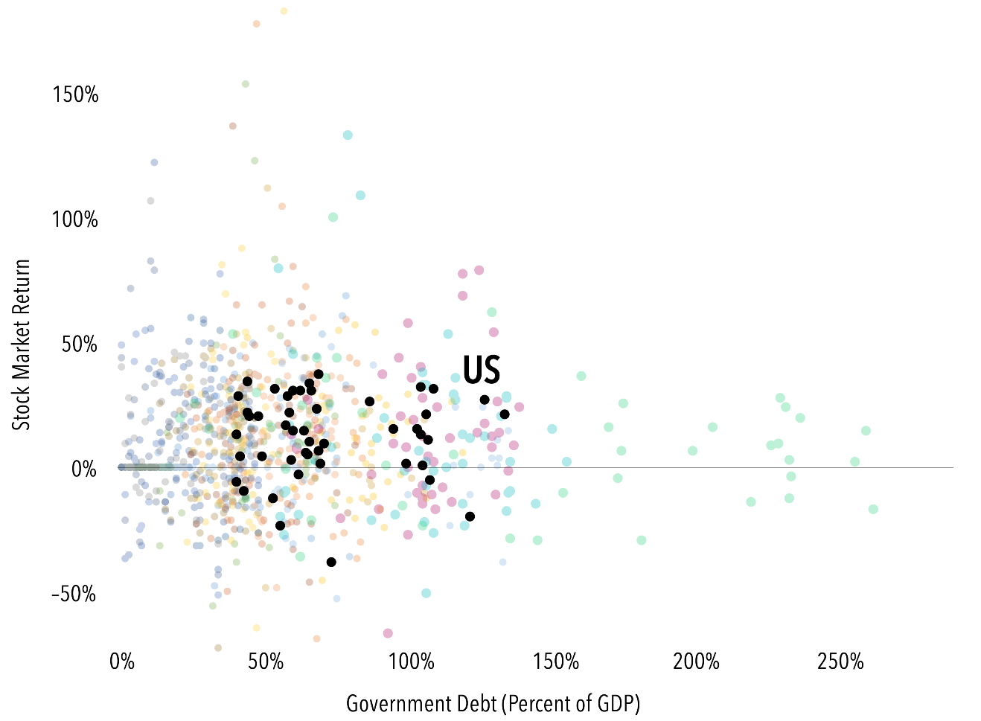
Country Debt and Stock Returns
Fourth quarter 2023
Wes Crill, PhD, Senior Investment Director and Vice President, Dimensional Fund Advisors
US government debt reached 121% of the value of the country’s gross domestic product (GDP) last year.¹ Many investors have expressed concern over the impact that servicing this level of debt could have on the stock market. But the historical data show little relation between the two. Since 1975, there have been 153 observations of a country exceeding 100% debt/GDP for a year. Stocks were up for that country/year in 104 of the 153, or about two-thirds of
the time.
There are numerous examples of countries carrying high debt for extended periods. Italy and Belgium have both been over 100% debt/GDP in more than 30 of the past 48 years. Meanwhile, their stock markets have returned an average of 10.8% and 12.0% per year, respectively. Japan has been over 200% since 2010 while its market averaged close to 6% per year over that period.
Stock markets set prices to the point where investors have a positive expected return given current information. Country debt is a slow-moving variable, so it’s sensible that current prices reflect expectations about the effect of government debt. And it’s unsurprising to see stock performance has generally been positive even amid high-debt conditions.
INDEBTED
General government debt, percent of GDP vs. stock market return for developed markets, 1975–2022
1. “General Government Debt,” Global Debt Database, International Monetary Fund, September 2023.
See following page for important disclosure.
135208

Slide 16
Country Debt and Stock Returns
(continued from page 15)
Past performance is no guarantee of future results.
Debt figures are based on General Government Debt data from the Global Debt Database published by the International Monetary Fund. MSCI index returns are net dividends, in USD. MSCI data © MSCI 2024, all rights reserved.
Disclosures
The information in this material is intended for the recipient’s background information and use only. It is provided in good faith and without any warranty or representation as to accuracy or completeness. Information and opinions presented in this material have been obtained or derived from sources believed by Dimensional to be reliable, and Dimensional has reasonable grounds to believe that all factual information herein is true as at the date of this material. It does not constitute investment advice, a recommendation, or an offer of any services or products for sale and is not intended to provide a sufficient basis on which to make an investment decision. Before acting on any information in this document, you should consider whether it is appropriate for your particular circumstances and, if appropriate, seek professional advice. It is the responsibility of any persons wishing to make a purchase to inform themselves of and observe all applicable laws and regulations. Unauthorized reproduction or transmission of this material is strictly prohibited. Dimensional accepts no responsibility for loss arising from the use of the information contained herein.
This material is not directed at any person in any jurisdiction where the availability of this material is prohibited or would subject Dimensional or its products or services to any registration, licensing, or other such legal requirements within the jurisdiction.
“Dimensional” refers to the Dimensional separate but affiliated entities generally, rather than to one particular entity. These entities are Dimensional Fund Advisors LP, Dimensional Fund Advisors Ltd., Dimensional Ireland Limited, DFA Australia Limited, Dimensional Fund Advisors Canada ULC, Dimensional Fund Advisors Pte. Ltd., Dimensional Japan Ltd., and Dimensional Hong Kong Limited. Dimensional Hong Kong Limited is licensed by the Securities and Futures Commission to conduct Type 1 (dealing in securities) regulated activities only and does not provide asset management services.
RISKS
Investments involve risks. The investment return and principal value of an investment may fluctuate so that an investor’s shares, when redeemed, may be worth more or less than their original value. Past performance is not a guarantee of future results. There is no guarantee strategies will be successful.
Dimensional Fund Advisors LP is an investment advisor registered with the Securities and Exchange Commission.
Investment products: • Not FDIC Insured • Not Bank Guaranteed • May Lose Value
Dimensional Fund Advisors does not have any bank affiliates.
135209

