Slide 1
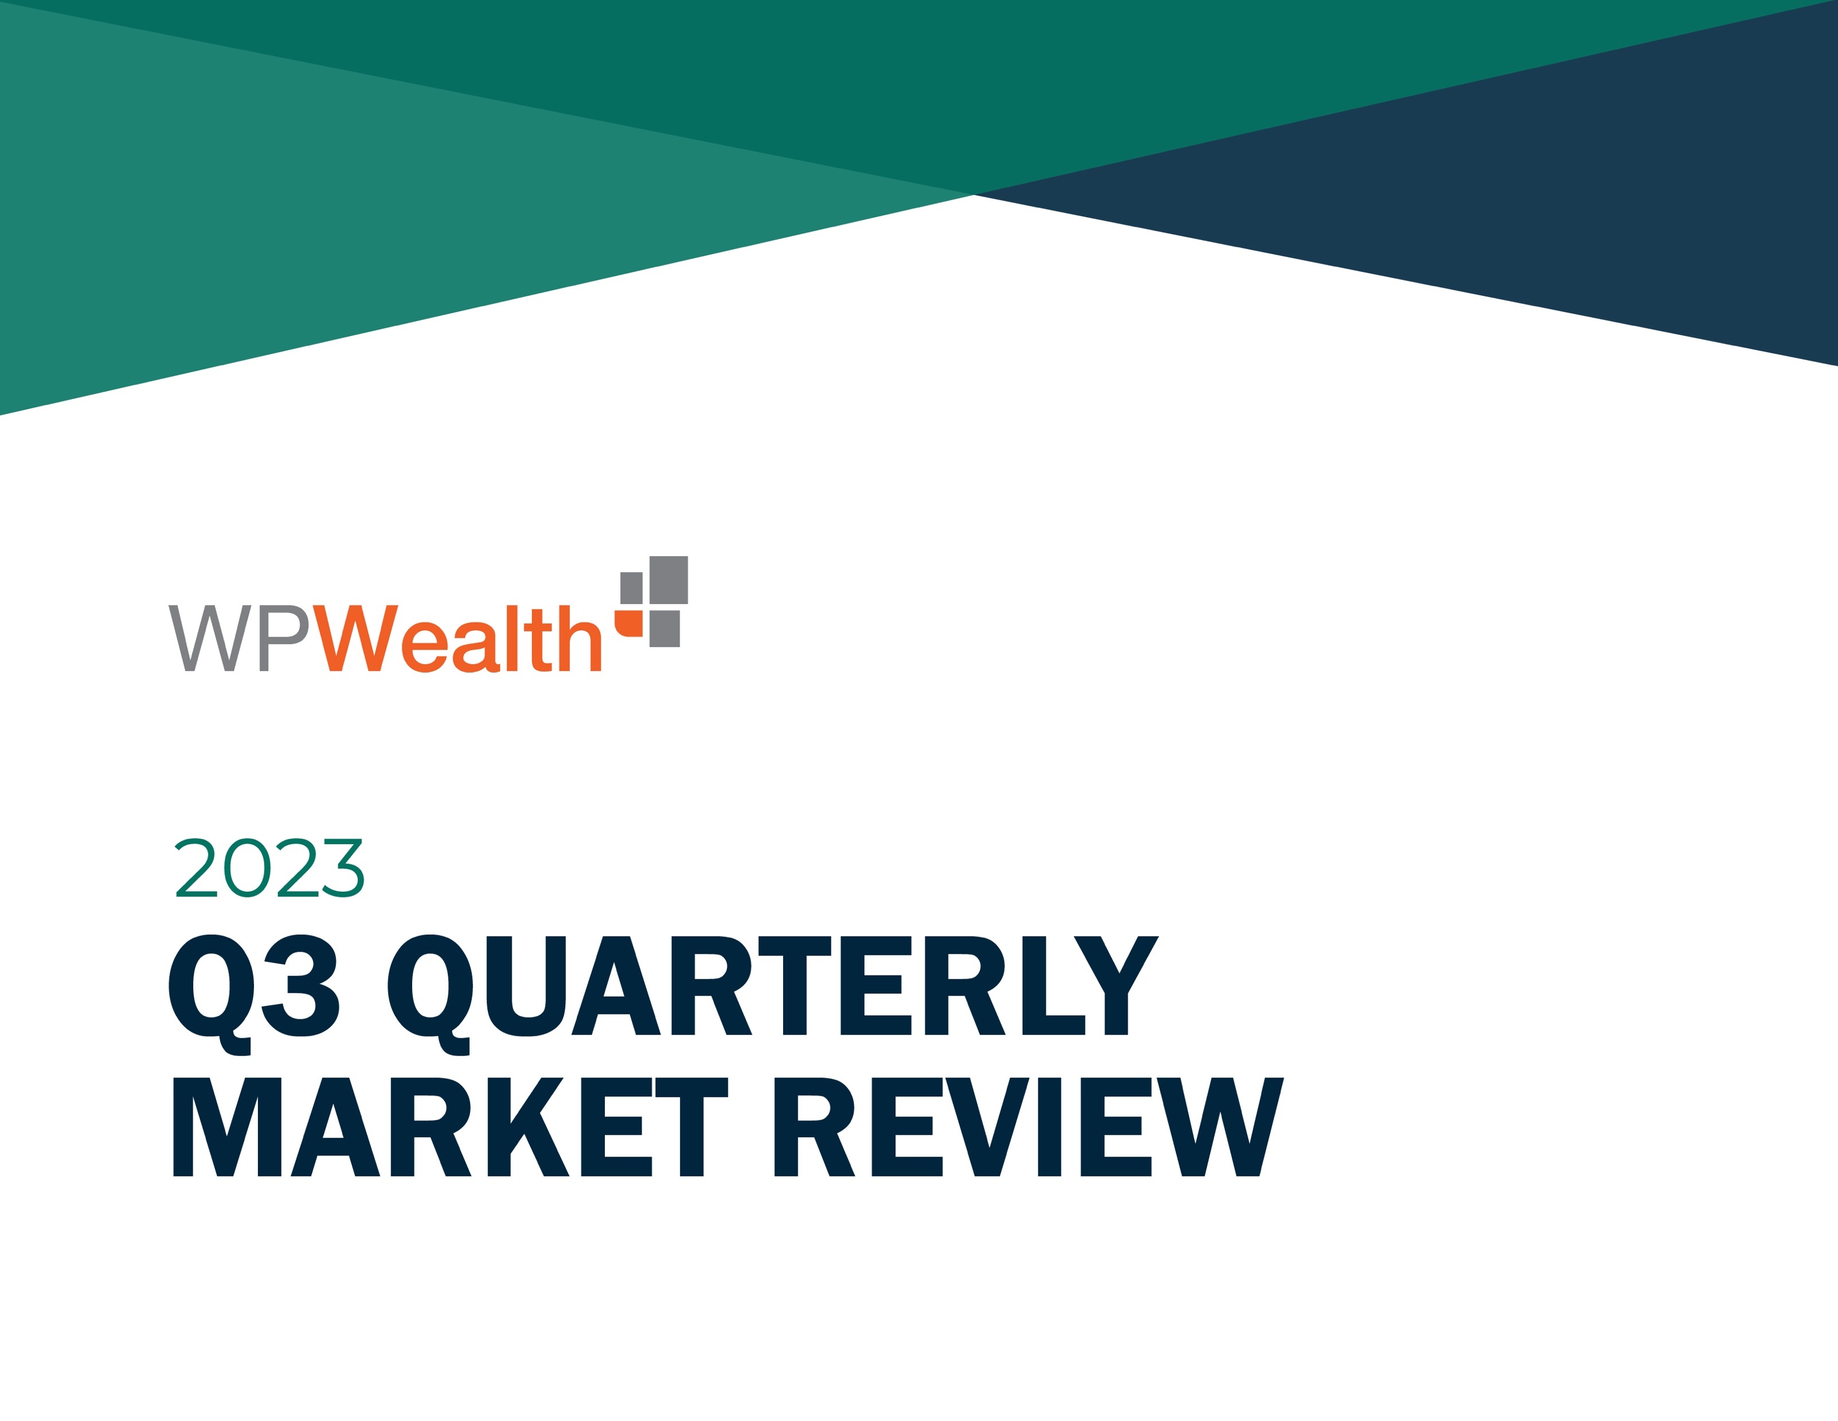
Q3
Quarterly Market Review
Third Quarter 2023
135202

Slide 2

Quarterly Market Review
Third quarter 2023
This report features world capital market performance and a timeline of events for the past quarter. It begins with a global overview, then features the returns of stock and bond asset classes in the US and international markets. The report concludes with a quarterly topic.
Overview:
  Market Summary
  World Stock Market Performance
  US Stocks
  International Developed Stocks
  Emerging Markets Stocks
  Country Returns
  Real Estate Investment Trusts (REITs)
  Commodities
  Fixed Income
  Global Fixed Income
  Quarterly Topic: When Value Delivers
135210

Slide 3
Quarterly Market Summary
Index returns
 | US Stock Market | International Developed Stocks | Emerging Markets Stocks | Global Real Estate |  | US Bond Market | Global Bond Market ex US
Q3 2023 | STOCKS |  |  |  |  | BONDS
 | -3.25% | -4.10% | -2.93% | -6.49% |  | -3.23% | -0.78%
Since Jan. 2001
Average Quarterly Return | 2.2% | 1.5% | 2.4% | 2.1% |  | 0.9% | 0.9%
Best | 22.0% | 25.9% | 34.7% | 32.3% |  | 4.6% | 4.6%
Quarter | 2020 Q2 | 2009 Q2 | 2009 Q2 | 2009 Q3 |  | 2001 Q3 | 2008 Q4
Worst | -22.8% | -23.3% | -27.6% | -36.1% |  | -5.9% | -4.1%
Quarter | 2008 Q4 | 2020 Q1 | 2008 Q4 | 2008 Q4 |  | 2022 Q1 | 2022 Q1
Past performance is not a guarantee of future results. Indices are not available for direct investment. Index performance does not reflect the expenses associated with the management of an actual portfolio.
Market segment (index representation) as follows: US Stock Market (Russell 3000 Index), International Developed Stocks (MSCI World ex USA Index [net dividends]), Emerging Markets (MSCI Emerging Markets Index [net dividends]), Global Real Estate (S&P Global REIT Index [net dividends]), US Bond Market (Bloomberg US Aggregate Bond Index), and Global Bond Market ex US (Bloomberg Global Aggregate ex-USD Bond Index [hedged to USD]). S&P data © 2023 S&P Dow Jones Indices LLC, a division of S&P Global. All rights reserved. Frank Russell Company is the source and owner of the trademarks, service marks, and copyrights related to the Russell Indexes. MSCI data © MSCI 2023, all rights reserved. Bloomberg data provided by Bloomberg.
135211

Slide 4
Long-Term Market Summary
Index returns as of September 30, 2023
 | US Stock Market | International Developed Stocks | Emerging Markets Stocks | Global Real Estate |  | US Bond Market | Global Bond Market ex US
1 Year | STOCKS |  |  |  |  | BONDS
 | 20.46% | 24.00% | 11.70% | 2.03% |  | 0.64% | 2.99%
5 Years
 | 9.14% | 3.44% | 0.55% | 0.01% |  | 0.10% | 0.83%
10 Years
 | 11.28% | 3.84% | 2.07% | 3.12% |  | 1.13% | 2.30%
Past performance is not a guarantee of future results. Indices are not available for direct investment. Index performance does not reflect the expenses associated with the management of an actual portfolio.
Market segment (index representation) as follows: US Stock Market (Russell 3000 Index), International Developed Stocks (MSCI World ex USA Index [net dividends]), Emerging Markets (MSCI Emerging Markets Index [net dividends]), Global Real Estate (S&P Global REIT Index [net dividends]), US Bond Market (Bloomberg US Aggregate Bond Index), and Global Bond Market ex US (Bloomberg Global Aggregate ex-USD Bond Index [hedged to USD]). S&P data © 2023 S&P Dow Jones Indices LLC, a division of S&P Global. All rights reserved. Frank Russell Company is the source and owner of the trademarks, service marks, and copyrights related to the Russell Indexes. MSCI data © MSCI 2023, all rights reserved. Bloomberg data provided by Bloomberg.
135212

Slide 5
World Stock Market Performance
MSCI All Country World Index with selected headlines from Q3 2023
1 year (Q4 2022–Q3 2023)
Last 3 months
Q3 2023
Sep 30
“Japan's Economy Grows at 6% Pace in Second Quarter”
“Bank of England Holds Rates Steady for First Time in Nearly Two Years”
“S&P 500 Suffers Biggest Monthly Loss This Year”
“Dow Notches Longest Win Streak since 2017”
“US Factory Orders Plunge in July after Four Straight Gains”
“US Wages Rise More than 4% While Consumer Prices Increase 3%”
“China Slips Into Deflation in Warning Sign for World Economy”
“Iran Releases Five Americans in Exchange for Frozen Funds”
“US Stock Market’s August Losses Snap Monthslong Winning Streak”
“Turkey Agrees to Let Sweden In NATO”
“Fitch Slashes US Credit Rating to AA+ from AAA”
“UAW Strikes at Plants Owned by GM, Ford, Stellantis”
“Hollywood Studios and Writers Reach a Strike-Ending Deal”
“Wagner Chief Who Plotted Coup Presumed Dead in Russia Plane Crash”
“US New-Vehicle Sales Rise an Estimated 13% in First Half of the Year”
“S&P 500 Extends Winning Streak with Fifth Month of Gains”
“US Mortgage Rates Hit 7.09%, Highest in More than 20 Years”
“Oil Climbs 1.8% to End at a 10-Month High”
These headlines are not offered to explain market returns. Instead, they serve as a reminder that investors should view daily events from a long-term perspective and avoid making investment decisions based solely on the news.
Graph Source: MSCI ACWI Index (net dividends). MSCI data © MSCI 2023, all rights reserved. Index level based at 100 starting January 2000.
It is not possible to invest directly in an index. Performance does not reflect the expenses associated with management of an actual portfolio. Past performance is not a guarantee of future results.
135213

Slide 6
World Stock Market Performance
MSCI All Country World Index with selected headlines from past 12 months
Long Term (2000–Q3 2023)
Short Term (Q4 2022–Q3 2023)
Last 12 months
Sep 30
“China Braces for Deadly Covid Wave after Loosening Controls”
“S&P 500 Starts a New Bull Market as Big Tech Lifts Stocks”
“US PPI Report Shows Producer Prices Rose, Pointing to Persistent Inflation”
“Wagner Chief Who Plotted Coup Presumed Dead in Russia Plane Crash”
“S&P 500 Suffers Biggest Monthly Loss This Year”
“CEOs Say They Expect a US Recession, but Most Think It Will Be Short”
“US Signals Support for Allies to Send Their F-16 Jets to Ukraine”
“US Treasury Yield Curve Inverts to Deepest Level since 1981”
“China Slips Into Deflation in Warning Sign for World Economy”
“Sunak Wins Vote to Become UK’s Next Prime Minister after Truss Resigns”
“Dow Closes 700 Points Higher on Signs of Slowing Wage Growth”
“US Inflation Eased to 5% in March; Lowest Level in Nearly Two Years”
“US New-Vehicle Sales Rise an Estimated 13% in First Half of the Year”
“OPEC+ Agrees to Biggest Oil Production Cut since Start of Pandemic”
“US Stocks Close Out Worst Year since 2008”
“Silicon Valley Bank Closed by Regulators; FDIC Takes Control”
“Fed Holds Rates Steady but Expects More Increases”
“UAW Strikes at Plants Owned by GM, Ford, Stellantis”
These headlines are not offered to explain market returns. Instead, they serve as a reminder that investors should view daily events from a long-term perspective and avoid making investment decisions based solely on the news.
Graph Source: MSCI ACWI Index (net dividends). MSCI data © MSCI 2023, all rights reserved. Index level based at 100 starting January 2000.
It is not possible to invest directly in an index. Performance does not reflect the expenses associated with management of an actual portfolio. Past performance is not a guarantee of future results.
135214

Slide 7
US Stocks
Third quarter 2023 index returns
The US equity market posted negative returns for the quarter and outperformed non-US developed markets, but underperformed emerging markets.
Value underperformed growth within large caps and outperformed within small caps.
Small caps underperformed large caps.
REIT indices underperformed equity market indices.
  Ranked Returns (%)
  World Market Capitalization—US
  Period Returns (%)
 |  |  |  | Annualized | * Annualized
Asset Class | QTR | YTD | 1 Year | 3 Years | 5 Years | 10 Years
Small Value | -2.96 | -0.53 | 7.84 | 13.32 | 2.59 | 6.19
Large Growth | -3.13 | 24.98 | 27.72 | 7.97 | 12.42 | 14.48
Large Cap | -3.15 | 13.01 | 21.19 | 9.53 | 9.63 | 11.63
Large Value | -3.16 | 1.79 | 14.44 | 11.05 | 6.23 | 8.45
Marketwide | -3.25 | 12.39 | 20.46 | 9.38 | 9.14 | 11.28
Small Cap | -5.13 | 2.54 | 8.93 | 7.16 | 2.40 | 6.65
Small Growth | -7.32 | 5.24 | 9.59 | 1.09 | 1.55 | 6.72
Past performance is not a guarantee of future results. Indices are not available for direct investment. Index performance does not reflect the expenses associated with the management of an actual portfolio. Market segment (index representation) as follows: Marketwide (Russell 3000 Index), Large Cap (Russell 1000 Index), Large Value (Russell 1000 Value Index), Large Growth (Russell 1000 Growth Index), Small Cap (Russell 2000 Index), Small Value (Russell 2000 Value Index), and Small Growth (Russell 2000 Growth Index). World Market Cap represented by Russell 3000 Index, MSCI World ex USA IMI Index, and MSCI Emerging Markets IMI Index. Russell 3000 Index is used as the proxy for the US market. Dow Jones US Select REIT Index used as proxy for the US REIT market. MSCI data © MSCI 2023, all rights reserved. Frank Russell Company is the source and owner of the trademarks, service marks, and copyrights related to the Russell Indexes.
135215

Slide 8
International Developed Stocks
Firm Logo
Third quarter 2023 index returns
Developed markets outside of the US posted negative returns for the quarter and underperformed both US and emerging markets.
Value outperformed growth.
Small caps outperformed large caps.
  Ranked Returns (%)
Value
Large Cap
Growth
Small Cap
  World Market Capitalization—International Developed
  Period Returns (%)
 |  |  |  | Annualized | * Annualized
Asset Class | QTR | YTD | 1 Year | 3 Years | 5 Years | 10 Years
Value | 0.19 | 9.13 | 28.89 | 11.64 | 3.05 | 3.05
Small Cap | -3.48 | 1.83 | 17.32 | 1.85 | 1.28 | 4.13
Large Cap | -4.10 | 6.73 | 24.00 | 6.07 | 3.44 | 3.84
Growth | -8.24 | 4.38 | 19.27 | 0.47 | 3.37 | 4.36
Past performance is not a guarantee of future results. Indices are not available for direct investment. Index performance does not reflect the expenses associated with the management of an actual portfolio.
Market segment (index representation) as follows: Large Cap (MSCI World ex USA Index), Small Cap (MSCI World ex USA Small Cap Index), Value (MSCI World ex USA Value Index), and Growth (MSCI World ex USA Growth Index). All index returns are net of withholding tax on dividends. World Market Cap represented by Russell 3000 Index, MSCI World ex USA IMI Index, and MSCI Emerging Markets IMI Index. MSCI World ex USA IMI Index is used as the proxy for the International Developed market. MSCI data © MSCI 2023, all rights reserved. Frank Russell Company is the source and owner of the trademarks, service marks, and copyrights related to the Russell Indexes.
135216

Slide 9
Emerging Markets Stocks
Third quarter 2023 index returns
Emerging markets posted negative returns for the quarter and outperformed both US and non-US developed markets.
Value outperformed growth.
Small caps outperformed large caps.
  Ranked Returns (%)
  World Market Capitalization—Emerging Markets
  Period Returns (%)
 |  |  |  | Annualized | Annualized
Asset Class | QTR | YTD | 1 Year | 3 Years | 5 Years | 10 Years
Small Cap | 2.93 | 13.74 | 23.06 | 10.61 | 6.45 | 4.57
Value | -0.78 | 5.70 | 16.03 | 4.40 | 0.38 | 1.21
Large Cap | -2.93 | 1.82 | 11.70 | -1.73 | 0.55 | 2.07
Growth | -4.92 | -1.76 | 7.71 | -7.19 | 0.63 | 2.83
Past performance is not a guarantee of future results. Indices are not available for direct investment. Index performance does not reflect the expenses associated with the management of an actual portfolio. Market segment (index representation) as follows: Large Cap (MSCI Emerging Markets Index), Small Cap (MSCI Emerging Markets Small Cap Index), Value (MSCI Emerging Markets Value Index), and Growth (MSCI Emerging Markets Growth Index). All index returns are net of withholding tax on dividends. World Market Cap represented by Russell 3000 Index, MSCI World ex USA IMI Index, and MSCI Emerging Markets IMI Index. MSCI Emerging Markets IMI Index used as the proxy for the emerging market portion of the market. MSCI data © MSCI 2023, all rights reserved. Frank Russell Company is the source and owner of the trademarks, service marks, and copyrights related to the Russell Indexes.
135217

Slide 10
Country Returns
Third quarter 2023 index returns
Global
Past performance is no guarantee of future results.
Country returns are the country component indices of the MSCI All Country World IMI Index for all countries except the United States, where the Russell 3000 Index is used instead. Global is the return of the MSCI All Country World IMI Index. MSCI index returns are net dividend. Indices are not available for direct investment. Their performance does not reflect the expenses associated with the management of an actual portfolio. Frank Russell Company is the source and owner of the trademarks, service marks and copyrights related to the Russell Indexes. MSCI data © MSCI 2023, all rights reserved.
135203

Slide 11
Real Estate Investment Trusts (REITs)
Third quarter 2023 index returns
US real estate investment trusts underperformed non-US REITs during the quarter.
  Ranked Returns (%)
  Total Value of REIT Stocks
  Period Returns (%)
 |  |  |  | Annualized | Annualized
Asset Class | QTR | YTD | 1 Year | 3 Years | 5 Years | 10 Years
Global ex US REITS | -4.48 | -8.16 | 2.30 | -2.67 | -3.22 | 0.41
US REITS | -7.40 | -2.05 | 2.61 | 6.12 | 1.56 | 5.28
Past performance is not a guarantee of future results. Indices are not available for direct investment. Index performance does not reflect the expenses associated with the management of an actual portfolio. Number of REIT stocks and total value based on the two indices. All index returns are net of withholding tax on dividends. Total value of REIT stocks represented by Dow Jones US Select REIT Index and the S&P Global ex US REIT Index. Dow Jones US Select REIT Index used as proxy for the US market, and S&P Global ex US REIT Index used as proxy for the World ex US market. Dow Jones and S&P data © 2023 S&P Dow Jones Indices LLC, a division of S&P Global. All rights reserved.
135204

Slide 12
Commodities
Third quarter 2023 index returns
The Bloomberg Commodity Total Return Index returned +4.71% for the third quarter of 2023.
Low Sulphur Gas Oil and Heating Oil were the best performers, returning +43.22% and +39.15% during the quarter, respectively. Wheat and Kansas Wheat were the worst performers, returning -20.02% and -18.32% during the quarter, respectively.
  Ranked Returns (%)
Period Returns (%)
 |  |  |  | Annualized | Annualized
Asset Class | QTR | YTD | 1 Year | 3 Years | 5 Years | 10 Years
Commodities | 4.71 | -3.44 | -1.30 | 16.23 | 6.13 | -0.75
Past performance is not a guarantee of future results. Index is not available for direct investment. Index performance does not reflect the expenses associated with the management of an actual portfolio.
Commodities returns represent the return of the Bloomberg Commodity Total Return Index. Individual commodities are sub-index values of the Bloomberg Commodity Total Return Index. Data provided by Bloomberg.
135205

Slide 13
Fixed Income
Third quarter 2023 index returns
Interest rates increased across all bond maturities in the US Treasury market for the quarter.
On the short end of the yield curve, the 1-Month US Treasury Bill yield increased 31 basis points (bps) to 5.55%, while the 1-Year US Treasury Bill yield increased 6 bps to 5.46%. The yield on the 2-Year US Treasury Note increased 16 bps to 5.03%.
The yield on the 5-Year US Treasury Note increased 47 bps to 4.60%. The yield on the 10-Year US Treasury Note increased 78 bps to 4.59%. The yield on the 30-Year US Treasury Bond increased 88 bps to 4.73%.
In terms of total returns, short-term US treasury bonds returned +0.17% while intermediate-term US treasury bonds returned -0.81%. Short-term corporate bonds returned +0.25% and intermediate-term corporate bonds returned
-0.96%.¹
The total returns for short- and intermediate-term municipal bonds were -0.94% and -2.96%, respectively. Within the municipal fixed income market, general obligation bonds returned
-4.10% while revenue bonds returned -4.04%.²
US Treasury Yield Curve (%)
Bond Yield Across Issuers (%)
Yield to Maturity
Yield to Worst
Period Returns (%)
 |  |  |  | Annualized | Annualized
Asset Class | QTR | YTD | 1 Year | 3 Years | 5 Years | 10 Years
ICE BofA US 3-Month Treasury Bill Index | 1.31 | 3.60 | 4.47 | 1.70 | 1.72 | 1.11
ICE BofA 1-Year US Treasury Note Index | 1.21 | 2.90 | 3.68 | 0.60 | 1.46 | 1.00
FTSE World Government Bond Index 1-5 Years (hedged to USD) | 0.56 | 2.10 | 2.68 | -1.05 | 1.03 | 1.15
Bloomberg U.S. High Yield Corporate Bond Index | 0.46 | 5.86 | 10.28 | 1.76 | 2.96 | 4.24
FTSE World Government Bond Index 1-5 Years | -1.01 | -0.15 | 3.68 | -3.80 | -0.84 | -1.00
Bloomberg U.S. TIPS Index | -2.60 | -0.78 | 1.25 | -1.98 | 2.12 | 1.74
Bloomberg U.S. Aggregate Bond Index | -3.23 | -1.21 | 0.64 | -5.21 | 0.10 | 1.13
Bloomberg Municipal Bond Index | -3.95 | -1.38 | 2.66 | -2.30 | 1.05 | 2.29
Bloomberg U.S. Government Bond Index Long | -11.79 | -8.50 | -9.04 | -15.66 | -2.78 | 0.75
1. Bloomberg US Treasury and US Corporate Bond Indices.
2. Bloomberg Municipal Bond Index.
One basis point (bps) equals 0.01%. Past performance is not a guarantee of future results. Indices are not available for direct investment. Index performance does not reflect the expenses associated with the management of an actual portfolio. Yield curve data from Federal Reserve. State and local bonds and the Yield to Worst are from the S&P National AMT-Free Municipal Bond Index. AAA-AA Corporates represent the ICE BofA US Corporates, AA-AAA rated. A-BBB Corporates represent the ICE BofA Corporates, BBB-A rated. Bloomberg data provided by Bloomberg. US long-term bonds, bills, inflation, and fixed income factor data © Stocks, Bonds, Bills, and Inflation (SBBI) Yearbook™, Ibbotson Associates, Chicago (annually updated work by Roger G. Ibbotson and Rex A. Sinquefield). FTSE fixed income indices © 2023 FTSE Fixed Income LLC, all rights reserved. ICE BofA index data © 2023 ICE Data Indices, LLC. S&P data © 2023 S&P Dow Jones Indices LLC, a division of S&P Global. All rights reserved. Bloomberg data provided by Bloomberg.
135206

Slide 14
Global Fixed Income
Third quarter 2023 yield curves
US
UK
With the exception of the UK and Australia, interest rates generally increased across global developed markets for the quarter. In the UK, short- to intermediate-term rates decreased. In Australia, ultrashort-term rates decreased.
Realized term premiums were generally negative across global developed markets.
In Japan, ultrashort-term nominal interest rates were negative. In the UK, Germany, Canada, and Australia, the short-term segment of the yield curve was inverted.
Germany
Japan
Canada
Australia
  Changes in Yields (bps) since 06/30/2023
 | 1Y | 5Y | 10Y | 20Y | 30Y
US | 3.4 | 49.2 | 81.2 | 86.5 | 89.4
UK | -39.4 | -36.3 | 1.7 | 31.2 | 43.4
Germany | 14.7 | 18.7 | 42.1 | 54.6 | 60.4
Japan | 6.0 | 26.1 | 36.2 | 41.9 | 36.3
Canada | 15.6 | 61.8 | 76.7 | 75.2 | 73.7
Australia | -11.0 | 20.5 | 42.8 | 47.8 | 49.7
One basis point (bps) equals 0.01%. Source: ICE BofA government yield. ICE BofA index data © 2023 ICE Data Indices, LLC.
135207

Slide 15
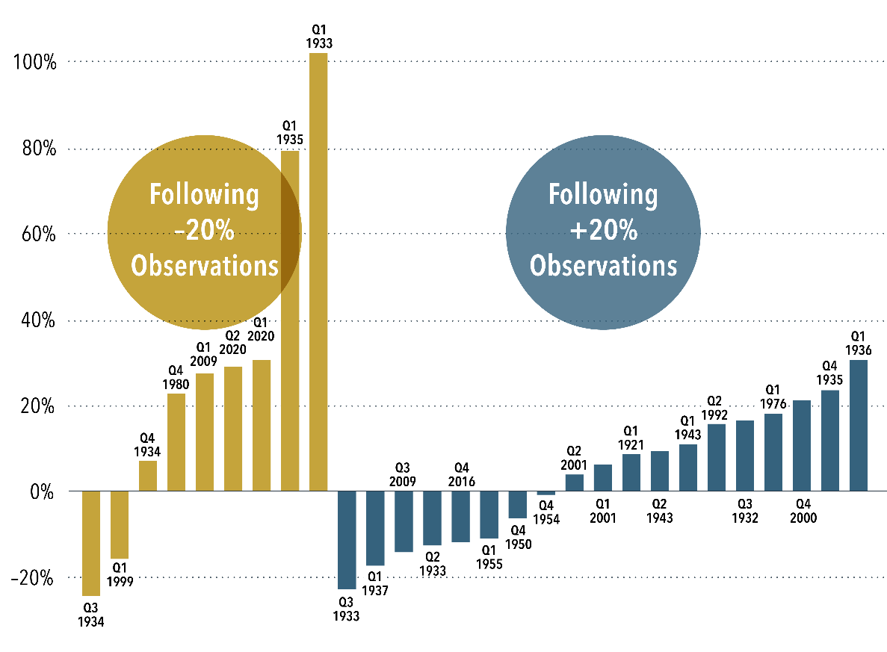
When Value Delivers
Third quarter 2023
Wes Crill, PhD, Senior Investment Director and Vice President, Dimensional Fund Advisors
The first half of 2023 marks the tenth time since 1926 that value stocks have underperformed growth stocks by more than 20 percentage points over a two-quarter period. More often than not, value has responded like the hero in an action movie, beating growth over the following four quarters in seven of the nine previous instances and averaging a cumulative outperformance of nearly 29 percentage points.
The sample size may be small, but a positive average value premium following a large negative period is not too surprising. In fact, looking at the other side of the value performance distribution, there have been 19 two-quarter periods with the value premium exceeding positive 20%. In 11 of these, value outperformance continued over the next four quarters. The average premium across all 19 was 3.6%.
It’s notoriously challenging to find an indicator that consistently predicts negative value premiums. Regardless of value’s recent performance, investors should expect positive value premiums going forward. That’s a strong incentive for investors to maintain a disciplined stance to asset allocation, so they can capture the outperformance when value stocks deliver.
Comeback Kid
Cumulative return difference for value minus growth in US stocks over the four quarters following two-quarter periods during which value underperformed by
–20% or outperformed by +20%.
See following page for important disclosure.

Slide 16
When Value Delivers—Disclosures
(continued from page 15)
Past performance is no guarantee of future results.
In USD. July 1926–June 2023. Quarterly returns for value and growth based on the Fama/French US Value Research Index and the Fama/French US Growth Research Index, respectively. Data provided by Fama/French. The Fama/French indices represent academic concepts that may be used in portfolio construction and are not available for direct investment or for use as a benchmark. Index returns are not representative of actual portfolios and do not reflect costs and fees associated with an actual investment. See “Index Descriptions” for descriptions of the Fama/French index data.
Index Descriptions: Fama/French US Value Research Index: Provided by Fama/French from CRSP securities data. Includes the lower 30% in price-to-book of NYSE securities (plus NYSE Amex equivalents since July 1962 and Nasdaq equivalents since 1973). Fama/French US Growth Research Index: Provided by Fama/French from CRSP securities data. Includes the higher 30% in price-to-book of NYSE securities (plus NYSE Amex equivalents since July 1962 and Nasdaq equivalents since 1973).
Disclosures
All expressions of opinion are subject to change. This information is not meant to constitute investment advice, a recommendation of any securities product or investment strategy (including account type), or an offer of any services or products for sale, nor is it intended to provide a sufficient basis on which to make an investment decision. Investors should consult with a financial professional regarding their individual circumstances before making investment decisions. Diversification neither assures a profit nor guarantees against loss in a declining market.
The information in this material is intended for the recipient’s background information and use only. It is provided in good faith and without any warranty or representation as to accuracy or completeness. Information and opinions presented in this material have been obtained or derived from sources believed by Dimensional to be reliable, and Dimensional has reasonable grounds to believe that all factual information herein is true as at the date of this material. It does not constitute investment advice, a recommendation, or an offer of any services or products for sale and is not intended to provide a sufficient basis on which to make an investment decision. Before acting on any information in this document, you should consider whether it is appropriate for your particular circumstances and, if appropriate, seek professional advice. It is the responsibility of any persons wishing to make a purchase to inform themselves of and observe all applicable laws and regulations. Unauthorized reproduction or transmission of this material is strictly prohibited. Dimensional accepts no responsibility for loss arising from the use of the information contained herein.
This material is not directed at any person in any jurisdiction where the availability of this material is prohibited or would subject Dimensional or its products or services to any registration, licensing, or other such legal requirements within the jurisdiction.
“Dimensional” refers to the Dimensional separate but affiliated entities generally, rather than to one particular entity. These entities are Dimensional Fund Advisors LP, Dimensional Fund Advisors Ltd., Dimensional Ireland Limited, DFA Australia Limited, Dimensional Fund Advisors Canada ULC, Dimensional Fund Advisors Pte. Ltd., Dimensional Japan Ltd., and Dimensional Hong Kong Limited. Dimensional Hong Kong Limited is licensed by the Securities and Futures Commission to conduct Type 1 (dealing in securities) regulated activities only and does not provide asset management services.
RISKS
Investments involve risks. The investment return and principal value of an investment may fluctuate so that an investor’s shares, when redeemed, may be worth more or less than their original value. Past performance is not a guarantee of future results. There is no guarantee strategies will be successful.
Dimensional Fund Advisors LP is an investment advisor registered with the Securities and Exchange Commission.
Investment products: • Not FDIC Insured • Not Bank Guaranteed • May Lose Value
Dimensional Fund Advisors does not have any bank affiliates.
135209

